Slide 1
Midterm Review
Session Eight

Slide 2
Reminders
Due Today
Due Next Week
Homework from last session
Quiz on last session’s content
Midterm study guide
Midterm will take place!
Notes:
Exciting news - the homework you are turning in today is your last homework of this format for the semester!

Slide 3
Reminders
Due Today
Due Next Week
Homework from last session
Quiz on last session’s content
Midterm study guide
Midterm will take place!
Notes:
Next week you’ll have the midterm and you are expected to turn in your study guide.

Slide 4
Agenda / Topics
1. Start of class & quiz
2. Midterm Prep Code Review
3. Practice Problem
4. Break
5. Practice Problems
6. Infosec topic review
6:30 - 7:00
7:00 - 7:40
7:40 - 8:00
8:00 - 8:15
8:15 - 8:45
8:45 - 9:00
Notes:
Today we’ll have a q&a to answer any last-minute burning questions from last week and then we’ll be doing the practice quiz. After that, we’ll start the lecture. We’ll cover a handful of topics with a break at 8 pm and we’ll wrap the class up before 9 pm.

Slide 5
Q&A
?
Notes:
Any last-minute questions before the quiz?

Slide 6
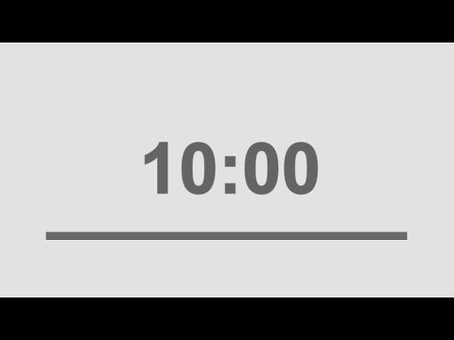
Quiz
Access the quiz here:
https://forms.gle/cRPXjmUWfqEi57ax6
Screenshot before submitting & don’t refresh.
Notes:
Alright! Here’s the quiz. Please remember to screenshot or otherwise record your answers before you hit submit and don’t refresh! Google forms will drop your answers if your connection drops. Please be prepared.
https://forms.gle/cRPXjmUWfqEi57ax6

Slide 7
Caesar Cipher & Midterm Prep
All submissions turned in on time (by Thursday @6 pm) get pass/fail graded without feedback unless the submission fails.
There is a detailed write-up on different solutions to the problem here so that you can review and compare your answer.
If you want specific feedback, there are additional extended office hours (April only) this week during which we can go over your answer and challenges. We can also do challenge problems and otherwise help prepare you for the midterm.
Office hours offered W, R, F 6:30-9PM
Office hours must be requested before 12 PM day-of.

Slide 8
Midterm Study Guide
Open-ended format (video, audio, virtual cards, code...comics? Macaroni art?)
Demonstrate intentional engagement with the material (must not be a direct scrape of powerpoints).
If a group submission we must be able to clearly distinguish your work and contributions from others.
Open-ended assignment - use whatever format works best for you but you MUST turn something in.
Notes:
See detailed write-up on midterm format and study guide requirements here:
https://docs.google.com/document/d/1BHWPRa_oXWzEE5_4F6UqZAnZvsvaKKIqolQ_ft5ajlY/edit?usp=sharing

Slide 9
Code Concepts review
From basic math through defining our own functions and importing libraries to access code others have written - we have learned a lot!

Slide 10
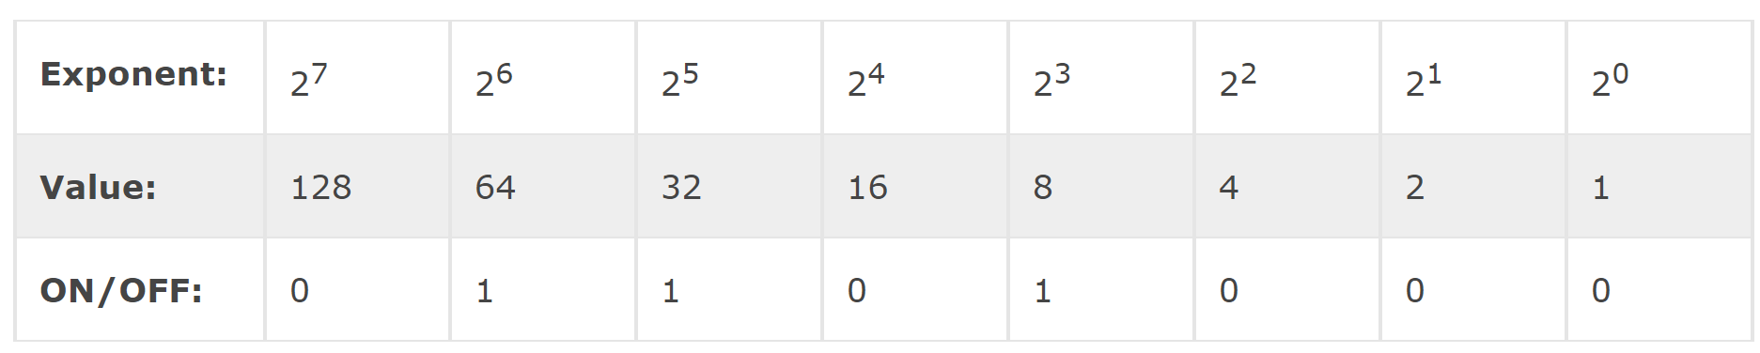
Bits, Bytes, and Binary!
Bits are the letters of binary language and bytes are words.
Bit = 1
Byte = 8 bits
The 0s and 1s are, of course, the binary.
Byte
Bit
Notes:
[Lauren] We started off the course by merging our understanding of some basic computing topics with our python learning. One of the foundational concepts we learned was that a bit is simply a binary digit. Bits are the smallest increment of data stored on a computer. A byte consists of 8 bits. One of the reasons the 8 bit unit, aka the byte, is so fundamental in computer science is because a byte contains enough information to store a single letter character. This is how we start to move from 0s and 1s up to letters and ultimately to pictures and beyond!
Note: As you can see on the slide 01101000 is a byte worth of data and any one of those digits is a bit.

Slide 11
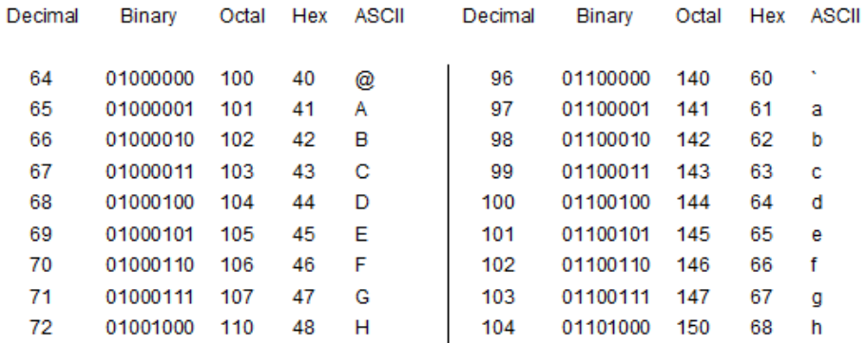
ASCII
Map of alphanumeric symbol to decimal value to binary value.
Notes:
[Lauren] We learned how computers get from low-level binary up to alphanumeric symbols. ASCII, the abbreviation of American Standard Code for Information Interchange, is a character encoding standard for electronic communication. ASCII codes represent text in computers. ASCII maps an alphanumeric symbol to a decimal number and from a decimal number, inherently, to binary!

Slide 12
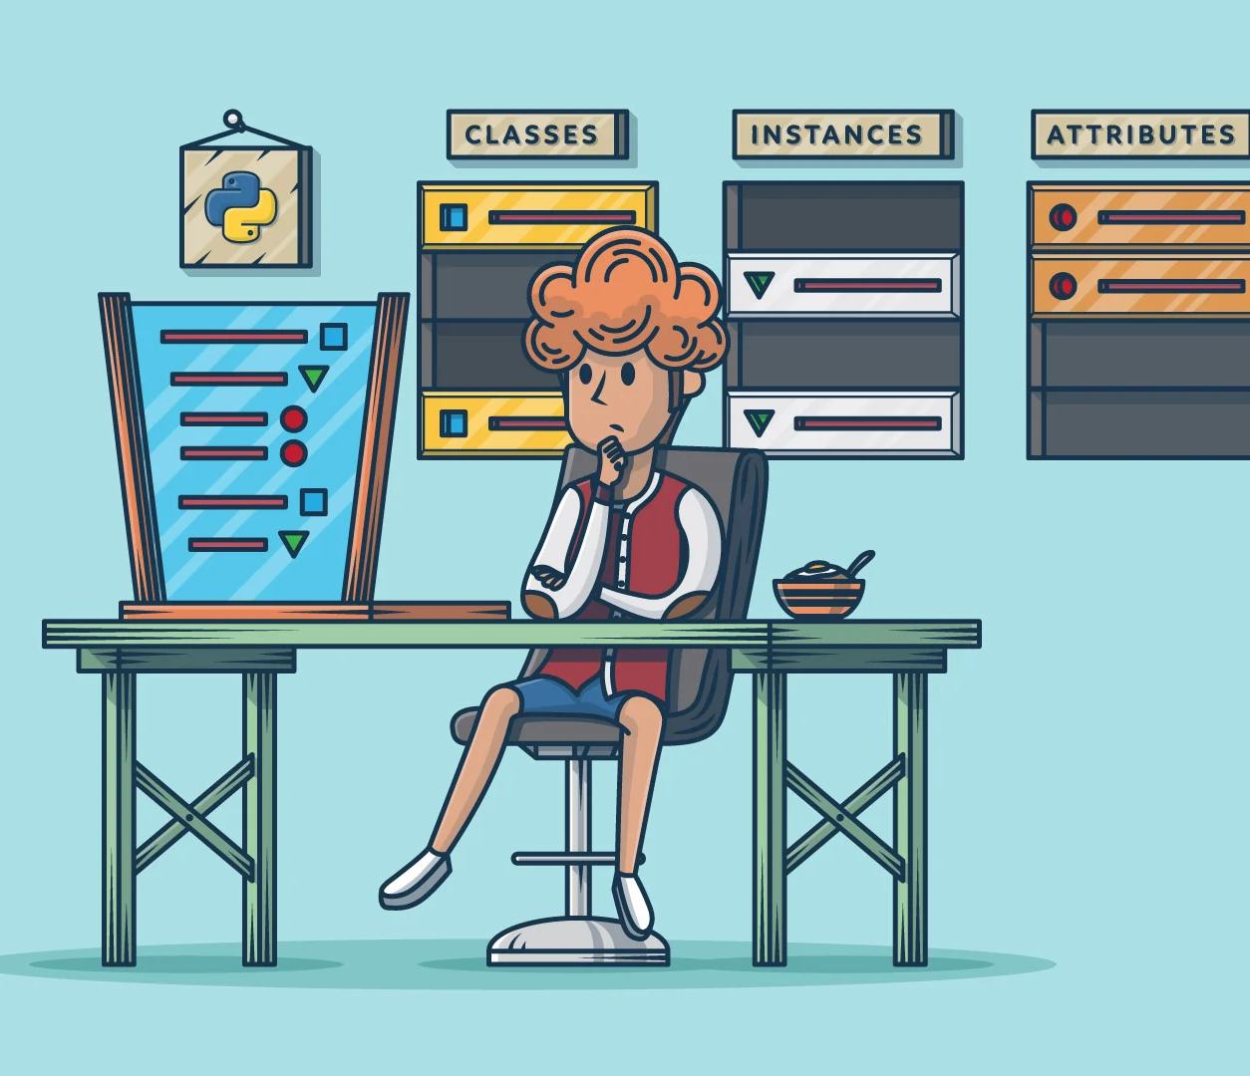
Data Storage in Python: Objects
Objects are one of the core elements of Python. Objects categorize different types of data.
Notes:
Beyond the basic computing concepts we started to dive into the python fundamentals and learned that storing data is a core component of how any language in computer science functions.
Python stores data in “first class” objects. All core data types that you might work with in Python - like text, numbers, and so on - are represented in python through the abstract concept of an object.
Objects are Python’s way of defining what type of thing something is, what properties that thing has and what can be done with it. Objects create clear rules and definition for code in order to help programmers know how to interact with and use it!
In Python, every object has a type, and all objects of that type have certain common properties and certain common functionalities.
Note: A note of caution, though! Everything in Python is an object, and this goes for the type function, too! type(x) will return a type object! So even if you ask Python the type of something and it prints the type as a string, note that Python is really returning another object!

Slide 13
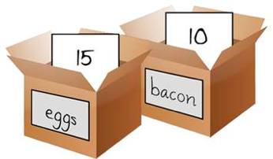
Variables
Variables are named containers for data
The type of data in a container can change
Assignment is name = contained_data
Names can be anything* but should generally be lower_case_with_underscore
* Many exceptions exist, mostly just don’t start with numbers or use reserved keywords, which we’ll talk about
Notes:
Variables in python stand in for different types of data in statements; however, it may be easier in practice to think of them like aliases or labels or nicknames, rather than as mathematical variables.
In Python, we create variables by giving them a name and a value. We do not have to specify up-front what type of data will be stored in the variable (this is a feature in some programming languages).
To create a variable, we use the assignment operator, the equal sign. A single equals sign in Python tells the language that the name on the left hand side of the operator should be a variable and the value on the right-hand side of the operator should be the value stored in that variable. The name on the left should be lowercase_with_underscores and the value on the right needs to be a valid type of data Python understands.
Note:
For example, to create a Python representation of the boxes on the screen, we would write the following code:
eggs = 15
bacon = 10
This tells Python to create two virtual ‘containers’, one called eggs and the other called bacon. In the container called eggs it will place the integer 15 and in the one called bacon it will place the integer 10.

Slide 14
Data Types: Integers
Integers are whole numbers with NO decimals. They may be positive, negative, or zero.
Technically, they must also fall in the value range between
-2,147,483,648 and 2,147,483,647.
Assignment:
x = 1
y = -2
z = 0
Notes:
At this point in class we should have a really strong understanding of different data types. The first data type we covered were integers.
In Python, an integer is a “whole number”, a numeric value with no decimal precision.
Decimal number values also require a specialized type called floating-point numbers, or floats.
Integers can be positive, negative, or zero but they must be whole and in the specified range.
To declare an integer, you merely need to set that integer equal to any whole number. There is no other syntax that identifies an integer - just the whole number.
Python has methods for working with integers and understands all of the mathematical operations you might want to do with them!

Slide 15
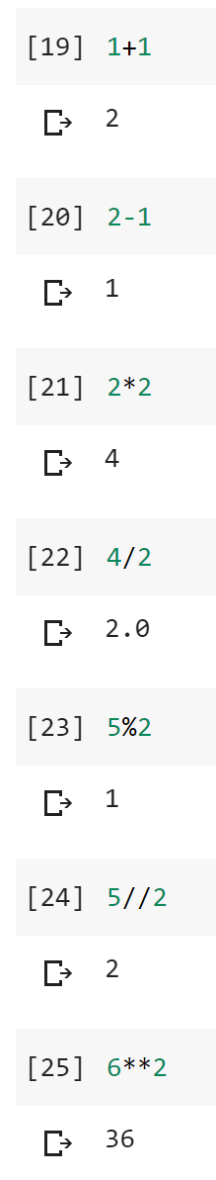
Arithmetic Math
Operator | Description
+ | Addition
- | Subtraction
* | Multiplication
/ | Division
% | Modulo
// | Floor division
** | Exponents
Notes:
Like assignment, there are other operators that Python uses to indicate different actions to take on data. For integers and other numeric data types, several familiar mathematical symbols are represented in Python. These include all of the items in the chart above on the left.
Most of these operations were likely familiar to everyone with the two exceptions of floor division (//) and modulo (%). Modulo gets remainders from division, and it’s often used in programming to shortcut a variety of different tasks.
Note:
There are a couple of syntax notes you will want to check out here - for example, exponentiation is a little different in Python. It uses two asterisks, not a carrot to indicate exponentiation. It also proceeds right to left when there are sequential exponentiations (e.g. 2**3**5 should be done as 3**5 and then 2**243).

Slide 16
Comparing Values
As mentioned before assigning values means that a variable represents a specific item. This is different than comparing values which is asking the question “does this item have this specific relationship to this other item?”
Operator | Comparison Being Made
== | Are these two things equal to each other?
!= | Is this thing not equal to this other thing?
> | Is this thing greater than that thing?
< | Is this thing less than that thing?
>= | Is this thing greater than or equal to that thing?
<= | Is this thing less than or equal to that thing?
Notes:
We also learned about comparisons in python. Critically we learned that we can use syntax such as bang equals sign to mean not equal to and we will get a boolean respnoes of True or False.
A small but important syntax note is that greater than or equal to and less than or equal to both put the equal sign last and the greater/less than sign first.

Slide 17
Data Types: Floats 1.0 2. 300.1 400.21 5000.919 6001.6001
Floating Point Numbers
Decimal values / fractions
x = 1.0
Notes:
Floating point precision numbers, AKA floats, are what are used in Python to represent decimal values. Any numeric value with a decimal is a float, even if that value could be represented as a whole number (e.g. 1.0).
Floating point numbers can be positive, zero, or negative. But they are always represented with a decimal. This is also how they are declared.
NB:
Floats will generally behave exactly as you would expect decimals to behave in normal mathematical use, but there are some exceptions to be aware of. In particular, beware the Representation Error (https://docs.python.org/3/tutorial/floatingpoint.html#representation-error).
“Representation error refers to the fact that some (most, actually) decimal fractions cannot be represented exactly as binary (base 2) fractions. This is the chief reason why Python (or Perl, C, C++, Java, Fortran, and many others) often won’t display the exact decimal number you expect.
Why is that? 1/10 is not exactly representable as a binary fraction.”
Consider:
>>> 0.1 + 0.2
0.30000000000000004
Just something to keep in mind when working with floats if you have a high-precision calculation! In normal usage this is unimportant and in the security space you generally won't have to be concerned about this. But it’s good to know.

Slide 18
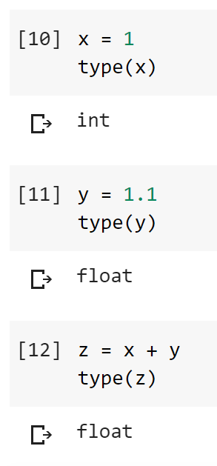
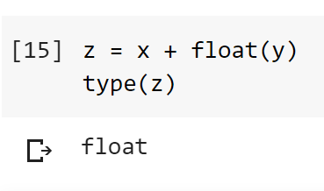
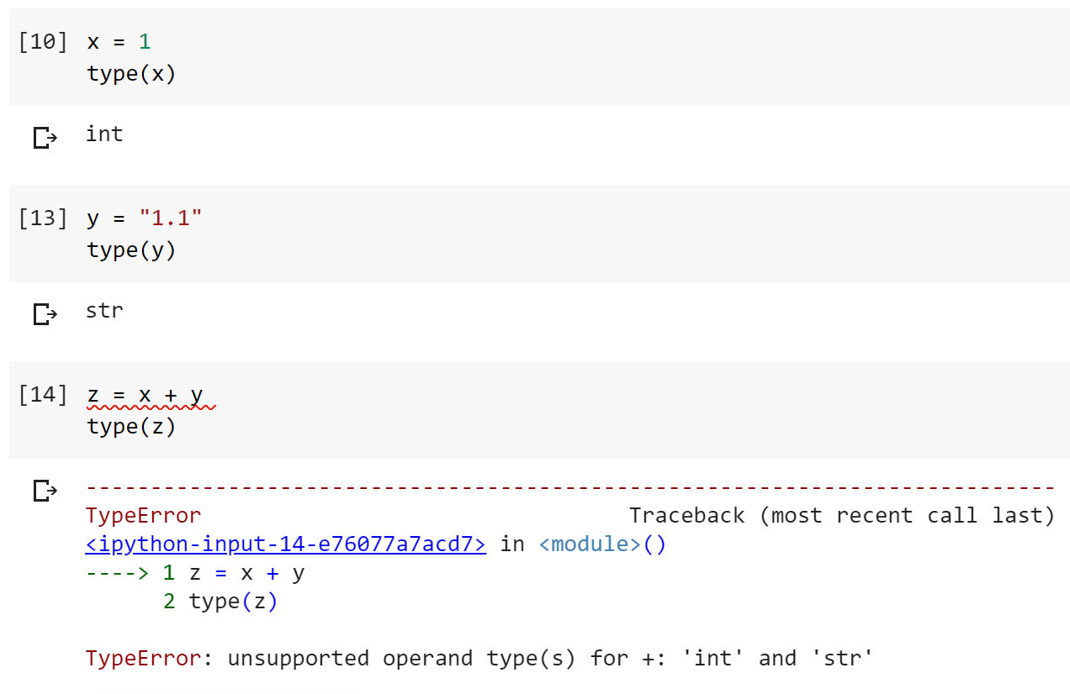
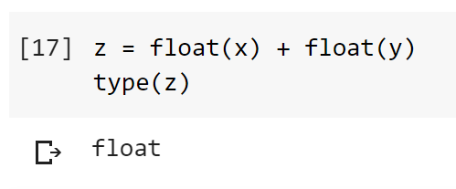
Implicit vs explicit conversion
The x is implicitly converted and the y is explicitly converted:
Both are explicitly converted:
Notes:
Python provides ways to convert between integers and floats. The process of converting data from any one type to another is called type conversion.
You’ll also hear the phrases casting or type-casting used; we’re not going to get into the philosophical debate between these terms; for now, consider them all to be the same thing.
Python supports two different types of type conversion, implicit conversion and explicit conversion.
In implicit conversion, Python will automatically convert types under the hood. Converting from an integer to a float is an example of this.
Python understands intuitively that you want to add an integer and a float, and that integers can be represented as floating point values with no decimal point value. Floats, on the other hand, cannot be represented as integers consistently - our value of 1.1 would need to be rounded up or down to be represented as an integer, and that would result in data loss.
An integer is an example of a lower data type than a float. You can convert the integer into a float, but not the other way around, without data loss.
So, Python understands what you want to do and that there’s only one way to do it - to convert the integer to a float to avoid that data loss. Python will convert from the lower data type to the higher data type for you under the hood and return your result - 1.1 - as the higher type - the floating-point value.
Programmers can cast explicitly and tell Python how they want an operation handled. This is the process of explicit type conversion. The programmer can say something like the following:
z = x + float(y) # the x is still implicitly converted and the y is explicitly converted
or
z = float(x) + float(y) # both are explicitly converted
to tell Python what they intended.
Wrapping data - whether that data is in a variable (e.g. float(x)) or represented as raw values (e.g. float(“1.1”)) in the name of the type you want to convert to and then a pair of parentheses will tell Python you want it to convert the type of the data for the purposes of an operation.

Slide 19
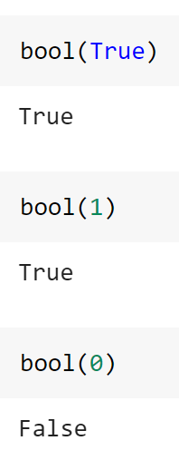
Data Types: Booleans True False
Booleans only return one of two responses: true or false.
Boolean responses have an integer representation as well:
True → 1
False → 0
^ Remember that == is used for comparisons not assignment.
Notes:
Booleans only have two possible values - True and False. True can be represented as 1 and False can be represented as 0. Remember that we discussed reserved words and True and False are both reserved words. This is why.

Slide 20
Data Types: Lists
Lists are structures that can collect and contain objects in an ordered sequence.
Lists are declared with square brackets and their contents are separated by commas.
Lists’ contents may be referenced via their index/offset in the list, which starts at zero; to do this, use square brackets after the list.
x = 1
y = 2.0
z = [x, y, 3, 4, 5]
x = [1, 2, [3, 4, 5]]
x[0] # this will be the integer 1
x[1] # this will be the integer 2
[0, 1, 2, 3][0] # this will be the integer zero
Notes:
Lists store objects in an ordered sequence. A list can contain an ordered set of integers, floats, or other objects. A list can contain integers, floats, and other objects as well as variables representing more complex objects.
To declare a list, Python uses square brackets around the items the list will contain with each contained item separated by commas.
Lists are ordered by definition, and you can refer to items in a list using their position in the list, called an index. Indices in Python start counting from zero, rather than one.
This is common in most programming languages and derives from how memory addresses were set in precursor languages to C - the index represents an offset from the start of the array. Feel free to look this up if you want more background on this mechanic.
Lists can contain any other object type, including other lists. For example:
x = [1, 2, [3, 4, 5]]
This code is valid and will create a list stored in the variable x which is composed of three objects. In the zeroeth index, an integer with value 1; in the first index, an integer with value 2; and in the second index, a list containing the integers 3, 4, and 5 in that second lists’ zeroeth, first, and second indices, respectively.
Lists can be easily modified in a wide variety of ways using list-specific methods.
Note: Python lists can also contain themselves and you can get strange behavior (like infinitely recursive lists) if you do this. Generally not recommended and we’ll revisit this in later lectures.
For now, know that:
Lists are structures that can collect and contain objects in an ordered sequence.
Lists are declared with square brackets and their contents are separated by commas.
Lists’ contents may be referenced via their index/offset in the list, which starts at zero.

Slide 21
Data Types: Strings
my_string = “my text.”
my_string = ‘my text’
my_string = “““my
text””
Representation under the hood is as a specialized list; think “x = [m, y, , l, i, s, t, .]”
Notes:
Strings are structures that contain characters that Python can manipulate in various ways, but Python fundamentally has no idea how to read them in the way a human being would.
To Python, any text or characters that you want to store as strings are just as meaningful as squiggles. In fact, Python doesn’t even understand the idea of text. What Python understands when you create a string is that you want to manipulate a special form of list!
In Python, using single, double, or triple quotes (matching, on both sides) of text indicates to Python that you want to create a special kind of list where each of the values in the list is a symbol. Example:
my_string = “my list.”
Python will see this under the hood as something closer to:
x = [m, y, , l, i, s, t, .]
# note that you can’t actually store this in Python like this; Python doesn’t inherently understand any of these characters in its structure unless it’s either a variable or a string itself. This is just pseudocode for demonstration sake. You could store my_list = [‘m’, ‘y’, ‘ ’, ‘l’, ‘i’, ‘s’, ‘t’, ‘.’] of course, but this would then be a list that contains many strings within it. :)
Strings are objects that Python understands under the hood to work like lists but that, for our interactions as a programmer, are streamlined for typical text-based interactions. These special lists are designed to work well with different types of interactions we’d usually use for working with language, rather than more diverse or abstract types of data.
Note:
Before we move on from strings, it’s worth exploring how strings work with implicit and explicit conversion.
For example, if your string is a representation of a numeric type that Python can understand, you can using explicit conversion to force Python to recognize that it does understand the meaning of the string, for example:
x = “1.1”
y = float(x)
This conversion will work because Python can read 1.1 into a float. However, this is not true of most Python strings. Python can’t understand arbitrary text!
Errors or weird behaviors can happen if you try to force Python to derive meaning from things Python cannot understand. So be careful about how and when you try to convert or cast a string.

Slide 22
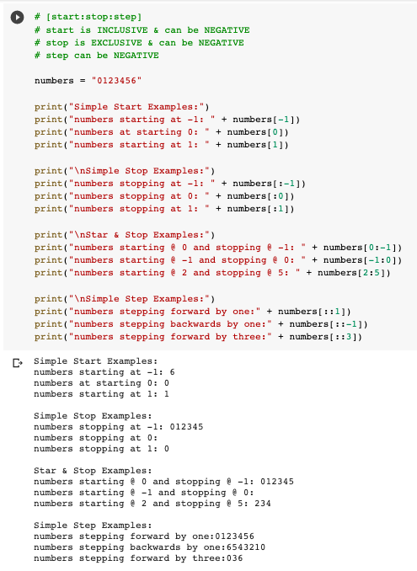
String Indexing [Start:Stop:Step]
Indexing into a string or list like some_iterable[some_index] is actually more complex than we told you last week. The full syntax is actually
string_or_list[start:stop:step].
Here are the rules for this:
Start is INCLUSIVE
Stop is EXCLUSIVE
All can be POSITIVE or NEGATIVE
Negative step goes in REVERSE
All can be OMITTED (treated as zero) but the colon is still required if you are doing anything other than start.
You can also REPLACE with this syntax ON LISTS but NOT STRINGS (strings are immutable)
Example when we get to lists.
Notes:
We went deeply into string slicing and learned that we can access items in a list by string slicing. We just need to specify the start:stop:step we want to access.

Slide 23
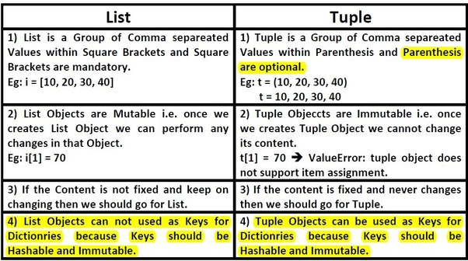
Data Types: Tuples
Tuples can be declared with parentheses around a series that is comma separated;
Tuples can be declared with the keyword tuple and parentheses as in type conversion;
Tuples cannot be changed after declaration;
Tuples are still ordered like lists
x = (1, 2)
x = 1, 2
warning, not a tuple:
x, y = 1, 2
Notes:
The next data type is the tuple.
Tuples are ordered, like lists, but they are distinctive in that the contents of a tuple can never be changed after they are assigned.
To declare a tuple, you place a comma-separated sequence within parenthesis. For example:
x = (1, 2)
Technically you can also create a tuple by having a series with no parenthesis declared, e.g.
x = 1, 2
However, this isn’t generally recommended; this is because in Python you can do assignment like:
x, y = 1, 2
and this will cause x to be equal to the integer one and y equal to two.
Note: Tuples may be of any length; however, tuples that contain one or fewer items cannot be declared with the parenthesis syntax and instead will need to be declared with the tuple type conversion syntax. This happens because Python can’t easily differentiate the use of parentheses for declaring non-series tuples from parentheses used in mathematical operations. If you want to create an empty or single-entry tuple, you’ll need to use the explicit tuple() declaration, like tuple() or tuple(1).
Tuples are often used in cases where you want to ensure that the data does not change or where there would never be a case to change it at all.
Note: Tuples also have some other benefits in certain contexts (for example, they use less memory than a list; or they can be used as keys in a dictionary where lists cannot).
For now, the important things to know are:
Tuples can be declared with parentheses around a series that is comma separated;
Tuples can be declared with the keyword tuple and parentheses as in type conversion;
Tuples cannot be changed after declaration;
Tuples are still ordered like lists;

Slide 24
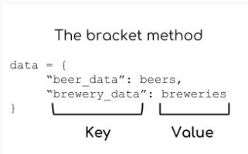
Data Types: Dictionaries {‘Nick’ : ‘SSP’, ‘Natasha’ : ‘MSFS’, ‘Kelley’ : ‘SSP’}
Dictionaries store multiple items of data as a list of key:value pairs. Dictionaries always contain data which is in relation to each other.
Unlike lists dictionary items are referenced by their key not by their index position.
Keys within dictionaries must be unique. Values do not need to be unique.
Notes:
Dictionaries store multiple items of data as a list of key:value pairs. Dictionaries always contain data which is in relation to each other.
Unlike lists dictionary items are referenced by their key not by their index position.
Keys within dictionaries must be unique. Values do not need to be unique.
Dictionaries provide a structure whereby data can be stored in key and value pairs where the key is unique and immutable; the assigned value may be data of any type, may be mutable, and may not be unique.
This structure allows the programmer to keep track of and look up data by its key when it’s required to do so.
There are also other more specialized forms of dictionaries that we’ll look at more later, but for now we’ll just talk about the normal Python dictionary.
This slide shows three ways of declaring a dictionary. The most common pattern you will see is the first one on the left. We’ll be focusing on this pattern for now.

Slide 25
Mutable and immutable data types
Mutable data types can be modified whereas immutable data types cannot.
Data type | Mutable?
Ints | no
Floats | no
Strings | no
Booleans | no
Lists | yes
Tuples | no
Sets | yes
Dictionaries | yes
x = 2
x = 3
Notes:
Different types of objects in Python behave differently under the hood! One of the core mechanics to know in Python when discussing object types is the concept of mutability - essentially, whether or not different types of objects can be modified fundamentally.
Integers and floats, which we’ve talked about so far, are both immutable types. What this means is that if you have an object of an immutable type, say
x = 2
if you change the value of x with another statement, like:
x = 2
x = 3
The object cannot be altered. Instead, Python will create a new object (named x) to replace the previous object with the new stored value.
Immutable objects are useful for certain constructs - such as dictionary keys, which we’ll talk about soon - and work differently than mutable types. Mutable types can be changed ad hoc as required in Python.

Slide 26
Data Types: Sets {‘Lauren’, ‘April’} {‘Jiwon’, ‘Talia’, ‘Brandon’}
Sets are lists of unique values. They cannot contain repetitive content.
Sets are extremely helpful for deduplicating data.
Notes:
A set is an unordered collection of hashable objects that cannot contain duplicates. Their implementation is similar to hashmap, if you are familiar, and they are used for set theory operations just like they would be in mathematics.
The benefits to sets are numerous; they enable you to compare collections of objects. You can check for things like whether or not one set is a subset of another; get items that are in the union or intersection of the set, and so on. In the security space, we use sets often when comparing collections of indicators of compromise or otherwise looking at overlaps between interesting information.
A set is declared either explicitly with the set keyword or by using curly braces around a series.

Slide 27
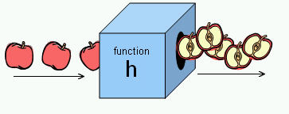
Functions & Methods
Functions & methods are Python’s way of calling arbitrary code from other places
They are often used to do repeatable tasks
Notes:
Functions and methods are Python’s way of calling arbitrary code from other places. Oftentimes this code will be used to do complex or commonly repeated actions.
You can think of a function conceptually as a set of instructions on how to accomplish a given task; often times, people depict this code visually as a box (as shown on the slide). You may or may not put input into the function box; the function box runs and does something; and it may or may not pass something back out as a result.
For example, the picture here shows a representation of a ‘slice’ function. Items, in this case apples, are passed in; the function slices each apple as it goes in; and, then, the slices are passed back out.

Slide 28
Imported Functions
In Python, you can borrow code that others have published. The process to do this is called importing.
# import an entire module / python file
import string
# import one specific piece of code from a module / python file
from string import capwords
# import one specific piece of code from a module / file and call it something specific
from string import capwords as cwords
Once you have code imported, you can access it and use it. Depending on how you imported it and what kind of code it is, you may have to refer to it in different ways.
Notes:
In python we are able to access code written by someone else and then we can use that code in our notebooks quite easily. Other people’s code is stored in Python files ending in .py and are called modules. We import modules to our notebook which makes it accessible to us for use.

Slide 29
Example Calls & Dot Notation
import string # nb from string import * is similar
string.capwords(‘this is my sentence’)
from string import capwords
capwords(‘this is my string.’)
from string import capwords as cwords
# custom function name used to avoid clashes
cwords(‘fix this for me pls.’)
Key:
Module / File
Function
Function Parameter (an object / variable being passed to a function)
Notes:
Let’s look at these imports and the code they import used in context.
In our first example, we import the entire string module. We want to use a specific example function that can be fund in the body of the module. So we refer to it by first stating the module that we want, then we place a dot. When you do this, Jupyter will automatically recognize this syntax - which is called dot notation - and will give you options for different functions and other parts of code that are accessible to you in the module. You can then select the function that you want, which will come directly after the dot.
All functions have parenthesis after the function name; this is part of Python’s maxim around explicit coding being better than implicit coding. Inside the parenthesis is where you will place data that you want to pass into the function (recall our example with the apples that are passed in in order to have them be sliced). If the parentheses are empty, that means nothing was passed in - but to be explicit, we still write the empty parentheses. Python expects and requires that we do this!
In the second example, we import a specific function from the string module instead of the entire string module. Since we’ve done this, we can refer to that function by name without specifying its parent. We can call capwords directly.
In the third example, we have imported only the specific function capwords from string; we have also given an alternative name we want to call it by. This can be helpful if you are importing code that has a common name to avoid collisions.

Slide 30
Dot Notation for Imported Functions
Some Module
import string
This contains code for...
These are separated by a DOT
This contains code for...
These are separated by a DOT
Some Function in Module
string.capwords()
import string
x = ‘lowercase’
string.capwords(x)
This may require one or more...
These are separated by PARENTHESES
This may require one or more...
These are separated by PARENTHESES
Parameters the Function Needs
some_lowercase_str
Notes:
Let’s break down what this syntax looks like one more time to make sure it’s really clear.
The diagram on the left shows a generic import process and the one on the right shows examples using the string module and capwords. ...

Slide 31
Parameters / Arguments
Some functions need no data to run. Others need to know additional things.
print() # What are we printing??
string.capwords() # What are we capitalizing??
Notes:
When you pass data to a function, that data is called an argument (or a parameter). Functions can be designed to take one, none, or multiple parameters.

Slide 32
Methods
Methods are a special kind of function. We’ll talk more about them later, but for now they are basically the same EXCEPT that they expect and require objects to be specified that they will operate on.
To use a method, you use dot notation, too. The difference is that methods require you to list the OBJECT they work on and THEN the dot and THEN the method (different from our imported functions form the last example which featured the MODULE then the DOT then the FUNCTION).
Notes:
We understand that functions and methods are Python’s way of calling arbitrary code. Methods are basically a specialized kind of function that sort of come with specific objects. Each type of object has different rules for how they can be interacted with, and each object fundamentally has two things: properties or features that the object has and things you can do with it.
Methods are the things you can do with it. For every single created object in Python, that object can have its own special set of custom functions that only work on it. These special custom functions are called methods.

Slide 33
Perils of Dot Notation: Module. function() or object.method()?
Is the following a function call or a method call? Or is it something else…?
string.capwords("capitalize this")
len("check the length of this")
"eeeeeeee".count("e")
"SwApCaSe".swapcase()
string.ascii_letters
"abcdefg012345".count(string.ascii_letters[0])
bool(len(string.capwords(string.ascii_letters.swapcase())[0]))
Notes:
To use an object’s methods, you first have to have an object. Then, you use a dot to specify you want to access that object’s attributes or methods. Then you choose the method that you want; you place parentheses after it, just like a function; you may still pass data into it; and the code will run.

Slide 34
Conditionals
Conditional logic enables you to create branches in your code so that if one scenario unfolds your code returns one answer, or proceeds to a specific set of code, and if another scenario unfolds you get a separate answer, or go to a different branch of code.
if
elif
else
These are the three terms used in conditional statements in Python.
If the professor is on-time commence class, elif the professor is less than ten minutes late commence class when professor arrives, else if the professor is ten or minutes late then students leave class.
Notes:
Conditional logic enables you to create branches in your code so that if one scenario unfolds your code returns one answer, or proceeds to a specific set of code, and if another scenario unfolds you get a separate answer, or go to a different branch of code.

Slide 35
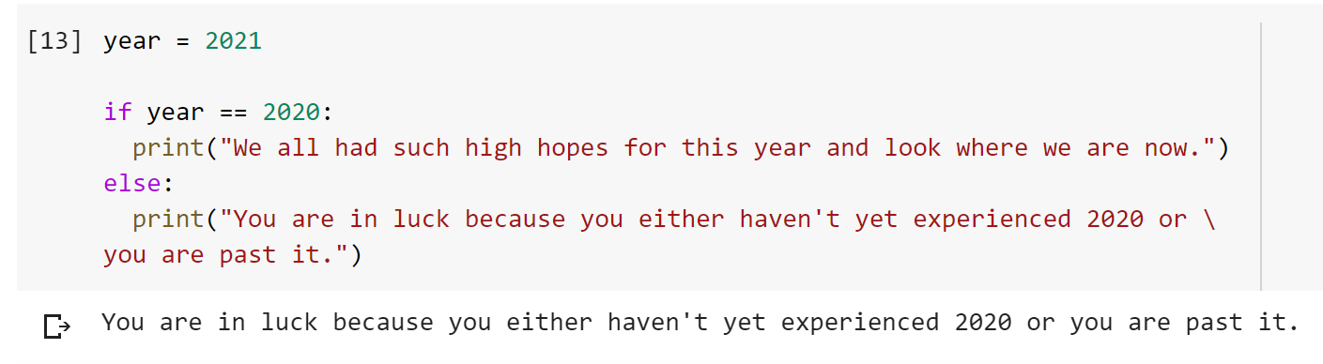
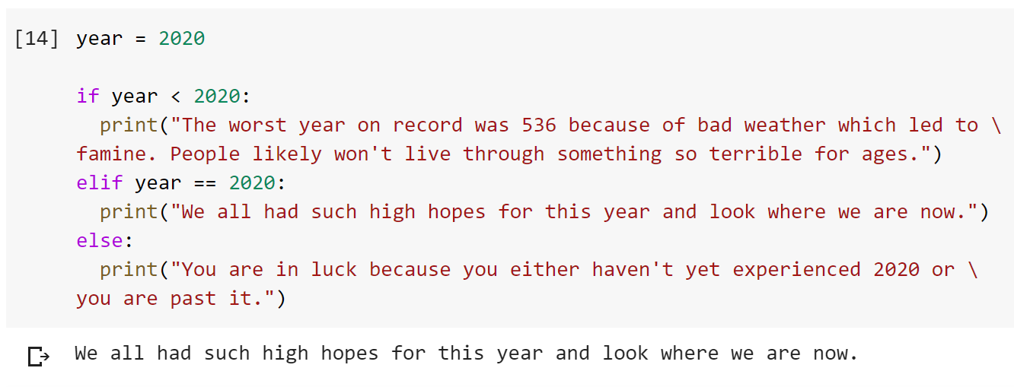
Using if, elif, and else
If you are testing two possible scenarios then you just need if and else.
If you are testing more than two scenarios use if for the first scenario, elif for the alternatives, and else for the final option.
Notes:
The important terms to understand here are if, elif, else. I say them in that order because that is the order in which they are used. See the example up top here. If you are testing two possible scenarios then you just need the if and else...note that means we are skipping elif. In the first example we are saying if the year is 2020 then print out this dire message. If the year is any year other than 2020 return a different message which is somewhat hopeful / full of warning.
Now we are going to move beyond two scenarios to three or more. If you are testing more than two scenarios use if for the first scenario, elif for the alternatives, and else for the final option. If you use elif you MUST also use else...otherwise you are incorrectly using elif as an else. You can use more than one elif to branch the code for multiple scenarios.

Slide 36
For Loops
For loops are used to loop over all items in a specified list.
Read them as “For each item in this specific list, do this specific thing.”
Example usage:
For each student in the course, assign them a random grade.
Notes:
For loops are used to loop over all items in a specified list. Read them as “For each item in this specific list, do this specific thing.”

Slide 37
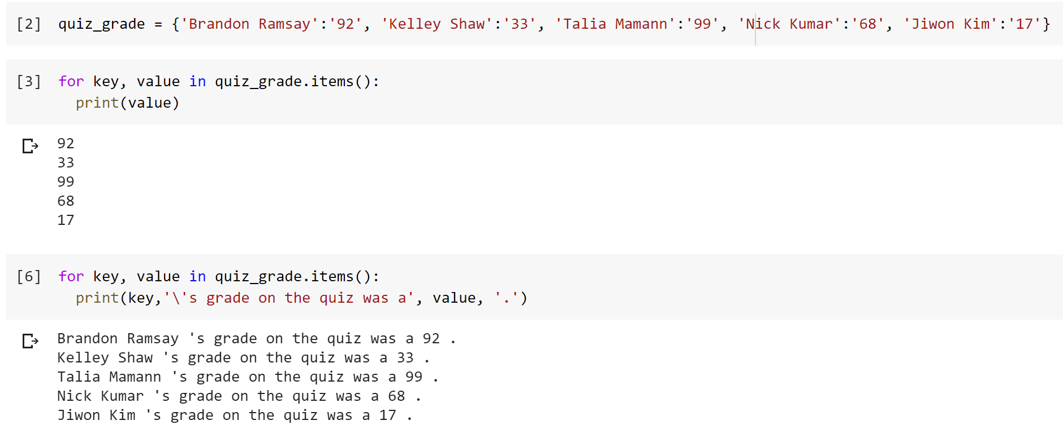
For loops
for each item in this list:
do this thing
Notes:
Our syntax is for each item in this list:
Do this thing
Note: So here are two examples of for loops in the wild. In the first for loop you can see that I have create a dictionary in which I have stored key:value pairs. These key:value pairs are students and their grades. This works well because each student’s name is unique and we know that the keys must be unique in a dictionary.
In our first for loop I am in a situation where I want to write some code to get me all of the grades for the class. I state “for each key:value pair in the quiz grade variable print out the values. Note, I used .items(). In Python, items() is a method used to return the key-value pairs of the dictionary, as tuples in a list.
In the second example we want to do something a touch more sophisticated. We want to return a string which includes the student’s name and the grade they received. Again, we can do this using a for loop. This time we just structure our print statement differently. Instead of printing just the value we will first print the key, which is the student’s name, then a specified set of text and then the grade they received. Note that I have the back-slash before the quote. That’s what you need to do to include a quote within a string (which is enclosed by quotes) without python interpreting the quote as the end of a string. You will see that there’s one small error in my code as I have a space between the student’s name and the apostrophe. This has to do with formatting and it should be easy for everyone to figure out what I did wrong through some use of google and the python docs. If you are looking for some practice working with the docs I suggest trying to figure out how you would write this more beautifully.

Slide 38
Summary: Midterm Concepts
Data Types
None
Integer
Floating Point
Boolean
String
List
Dictionary
Tuple
Set
Core Concepts
High & Low Level Programming Languages
Python
Notebooks & Deepnote
How to use Deepnote
Looking for code online, docs, tab completion, help
Pseudocode
Objects
Data types & Dynamic Typing
Operators
Casting & Conversion
Zen of Python
Use of Whitespace
Variables & Assignment
Naming Conventions & Pep8
Reserved Keywords
Multiple statements in one line
Truthiness & Falsiness
Applying Math & Comparison Operators to Strings
Soft Introduction: Iterables
Indices
Iterables
Mutability
Key, value pairs
JSON
Creating and manipulating dictionaries
Nesting
Operators
Arithmetic
Comparison
And, Or, Not
Use of : when setting off a conditional statement
: when used as a slice operator
Del
Keywords / Expressions
Conditional Statements (if, elif, else)
Slice Notation (aka [start:stop:step])
For Loop
List Comprehension
Functions
print()
display()
help()
type()
isinstance()
len()
chr()
ord()
sorted()
Methods
str.lower()
str.upper()
str.strip()
str.split()
str.splitlines()
str.join()
list.append()
list.extend()
list.remove()
list.clear()
list.pop()
list.sort()
dict.update()
dict.get()
dict.clear()
dict.pop()
dict.popitems()
dict.setdefault()
dict.items()
dict.keys()
dict.values()
dict.fromkeys()
set.union()
set.intersection()
set.difference()
set.update()
set.isdisjoint()
set.issubset()
set.clear()
set.add()
set.remove()
set.pop()
Coding Puzzle Resources:
edabit

Slide 39
Studying Approach Suggestions
How to study coding topics / study strategies
How to approach coding problems
Resources for studying

Slide 40
Study Strategies
Language Constructs: Recognizing what different components of the language are and how they work.
Algorithmic Thinking: Understanding which constructs will help you solve a problem and how to use them in context.
Recognize that there are two different skills that are being tested and two different subject areas.
Subject Area Expertise:
Familiarity with the security space and common elements of industry work. Contextual understanding.
Analytical Skill:
Ability to apply specific skills in the context of investigations & analysis.

Slide 41
Study
Strategies
Language Constructs: Recognizing what different components of the language are and how they work.
Algorithmic Thinking: Understanding which constructs will help you solve a problem and how to use them in context.
Scripting
Building self-quiz materials based on key terms, materials, and syntax for common constructs.
Practicing challenges that involve reading code, writing code, and debugging. Puzzles where you need to determine which constructs/concepts to apply.

Slide 42
Study
Strategies
Language Constructs: Recognizing what different components of the language are and how they work.
Physical or virtual flashcards can be helpful here. Consider making and trading these with others in the class.
All problems on language constructs should be answerable with slide content but some may be tricky in application.
Recognize that there are two different skills that are being tested and two different subject areas.
Common formats to expect:
Definitions / Concepts: “What does it mean that Python is dynamically typed?”
Edge Cases: “Is int(0.1) truthy or falsey?”
Syntax: “Where is the error in this code?”

Slide 43
Study
Strategies
Algorithmic Thinking: Understanding which constructs will help you solve a problem and how to use them in context.
Using coding sites to generate problems that you need to solve is a great strategy here. Solving dozens of problems will start to build familiarity for you with common constructs and you’ll start to see how certain patterns repeat.
Recognize that there are two different skills that are being tested and two different subject areas.
Common formats to expect:
Sort / filter: Given x input, sort or filter out components.
Count: Given x input, determine how many times a condition is met.
Find / Replace: Find where in a collection something occurs and modify it.

Slide 44
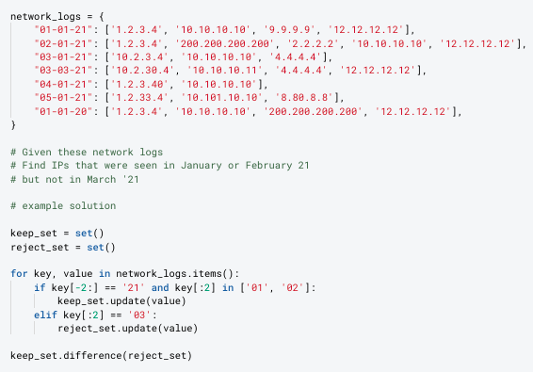
Example Problem

Slide 45
Example Solution

Slide 46
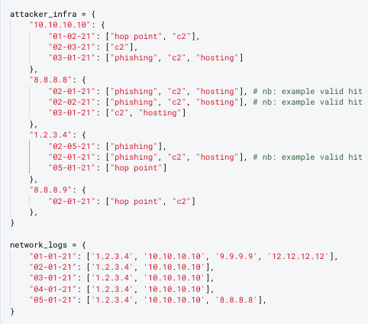
Example Problem
# Task: Determine if any of the IPs we saw on our network in February '21
# were used by attackers to host malware.

Slide 47
# Task: Determine if any of the IPs we saw on our network in February '21 were used by attackers to host malware.
Pseudocode (first phase)
Get a list/set of all of the IPs that were seen in February
Get a list/set of all of the IPs attackers used in February
Break this down by only those that were hosting
Find what's in common between them

Slide 48
# Task: Determine if any of the IPs we saw on our network in February '21 were used by attackers to host malware.
Pseudocode (Second phase)
Get a list/set of all of the IPs that were seen in February → iterate key, value pairs in network_logs and if they key starts with 02 and end with 21 with slice notation
Get a list/set of all of the IPs attackers used in February → wait, I don’t have to use sets here. I can just get the IPs that are in my list? Oh wait I could create a new dictionary based on the given one where I only copy out matching keys?
Break this down by only those that were hosting → and then I can check if hosting is in the value list. And that’s common by default because I only got keys that match.
Find what's in common between them

Slide 49
# Task: Determine if any of the IPs we saw on our network in February '21 were used by attackers to host malware.
Pseudocode (final phase)
# filter network_logs with a for loop and date slicing
# filter attacker_infra with the last result
# create a list for the final result
# iterate the new dict values and iterate the list
# make sure to only append out the hop point keys

Slide 50
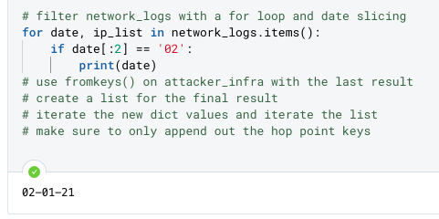
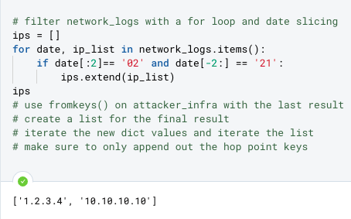
# Task: Determine if any of the IPs we saw on our network in February '21 were used by attackers to host malware.
Pseudocode (final phase)
# filter network_logs with a for loop and date slicing
# Test as I go
# filter attacker_infra with the last result
# create a list for the final result
# iterate the new dict values and iterate the list
# make sure to only append out the hop point keys

Slide 51
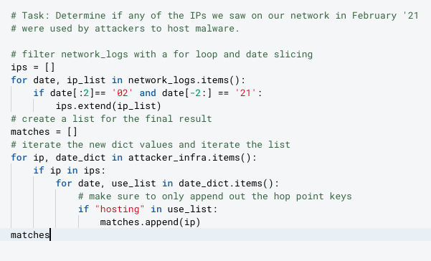
# Task: Determine if any of the IPs we saw on our network in February '21 were used by attackers to host malware.
You will definitely see a problem like this on the midterm. You need to be able to navigate nested list/dict structures.

Slide 52
Midterm Practice Problems
Click for demo notebook

Slide 53
Infosec topics review
To apply the python skills which you have learned to the field of cybersecurity you must have familiarity with the investigative disciplines, facility with technical concepts, and ability to conduct analysis and communicate analytical findings.
Notes:
To apply the python skills which you have learned to the field of cybersecurity you must have familiarity with the investigative disciplines, facility with technical concepts, and ability to conduct analysis and communicate analytical findings.

Slide 54
Sectors within the Cybersecurity industry
Security architecture
Vulnerability and patch management
Cyber threat intelligence
Security Operations Center (SOC)
Incident response
Security operations
Compliance
Network defense
Security risk assessment
Security audit
Cybersecurity project management
Penetration testing
Cyber threat hunting
Information security engineering

Slide 55

Espionage Meets the Internet
Espionage is the act of spying or secretly watching a person, company, government, etc. for the purpose of gathering secret information or detecting wrongdoing, and to transfer such information to another organization or state.
Cyber espionage is the combination of espionage and technology!

Slide 56
Advanced Persistent Threat (APT) Actors
“An adversary with sophisticated levels of expertise and significant resources, allowing it through the use of multiple different attack vectors (e.g., cyber, physical, and deception) to generate opportunities to achieve its objectives, which are typically to establish and extend footholds within the information technology infrastructure of organizations for purposes of continually exfiltrating information and/or to undermine or impede critical aspects of a mission, program, or organization, or place itself in a position to do so in the future; moreover, the advanced persistent threat pursues its objectives repeatedly over an extended period of time, adapting to a defender’s efforts to resist it, and with determination to maintain the level of interaction needed to execute its objectives.”
NIST
Notes:
In the field of cyber espionage we call the actors who conduct cyber espionage advanced persistent threat actors or APTs. The core aspects of the definition of who is considered an APT is that they are sophisticated, well funded, and have deep motivation to achieve their ends.

Slide 57
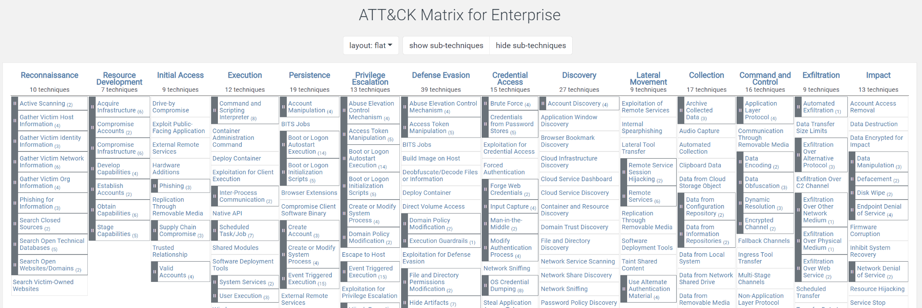
Tactics, Techniques, and Procedures (TTPs)
Tactics, Techniques, and Procedures = TTPs
Term used to refer to the behavior of an actor.
A tactic is the highest-level description of this behavior
Techniques give a more detailed description of behavior in the context of a tactic
And procedures an even lower-level, highly detailed description in the context of a technique.
Notes:
In the homework this week I saw that many people were conflating two terms IOCs and TTPs. I realize this is reasonable because we never taught you what a TTP is so I am adding it at the top of class this week. I do want to encourage everyone though in class to please ping into the chat or unmute and ask a question if we use a term with which you are not familiar. I did use TTP multiple times during class and it would have been helpful to everyone if you heard this term and didn’t recognize it if you had called me out for using a term which we hadn’t defined as a class. So don’t hesitate to do so - this homework exercise demonstrated that you would not have been alone in needing that definition.
TTP stands for tactics, techniques, and procedures but you will almost always hear just the acronym. TTPs is a term used to refer to the behavior of an actor. While each word does technically have a unique definition:
A tactic is the highest-level description of this behavior
Techniques give a more detailed description of behavior in the context of a tactic
And procedures an even lower-level, highly detailed description in the context of a technique.
Most people in the private sector cybersecurity world just refer to all three collectively as TTPs. It is rare to hear someone say “this is the procedure the actor used to gain access to the system” and more common to hear someone ask “What TTPs were used by the actor?”
In the second class we covered the ATT&CK Matrix and I explained that this framework categorizes and enumerates the possible TTPs an actor can use at each stage of an attack. I highly recommend going back now and reading through some of the items in this framework which should give you a good sense for the possible TTPs which an actor might use as part of an attack.

Slide 58
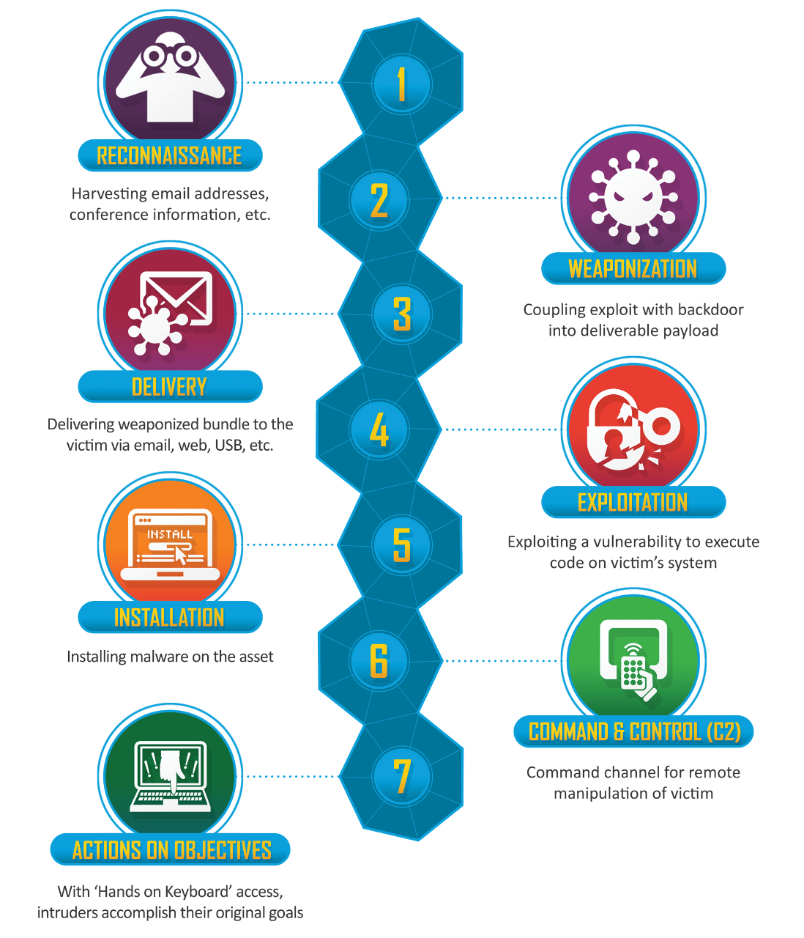
Many Names - Same APT?
Facebook, Google
Google, Microsoft, Telecomms
Anti-Virus Companies, Palo Alto Networks, FireEye
Apple, Microsoft, Anti-Virus Companies
CloudFlare, AWS
CrowdStrike, CarbonBlack, Malwarebytes, Cisco
Notes:
This image is, of course, the Lockheed Killchain.
Each organization who tracks APTs will have slightly different visibility into the activity. By that I mean that if you are a telecomm company then your purview includes interactions like phone calls and text messages. Therefore, you may have insight into which phone numbers are being used to send text-based phishing messages by APT actors and to whom they are being sent. However, if you are Google you will have insight into what searches those APT actors are conducting and what phishing emails they are sending. Finally, if you are AWS you may have information on what cloud infrastructure they are using to host their malware. Based on the data you have access to you will have a different view into the activity set and that will bias your understanding of the actor.
It is, therefore, possible that based on visibility two analysts could be tracking the same actor but have little hard technical evidence to connect the two cases. Or, the opposite, organizations could see overlap in their technical evidence and be tempted to call the cases the same activity set but could be wrong in doing so if they are missing key data which would indicate divergence.

Slide 59
Indicators of compromise (IOCs)
IP Address
Domain
URL
IPv4: 12.244.233.165
IPv6: 2001:0db8:0000:0000:0000:ff00:0042:7879
www.virustotal.com
https://www.virustotal.com/gui/home/search
Email Address
Phone Number
lbh22@georgetown.edu
610-724-8186
Malware Hash
md5: 3d95e1c94bd528909308b198f3d47620
sha256: 2b03806939d1171f063ba8d14c3b10622edb5732e4f78dc4fe3eac98b56e5d46
Notes:
As you start to work with IOCs it will be important for you to be able to recognize them and start to comfortably reference them in your work.

Slide 60
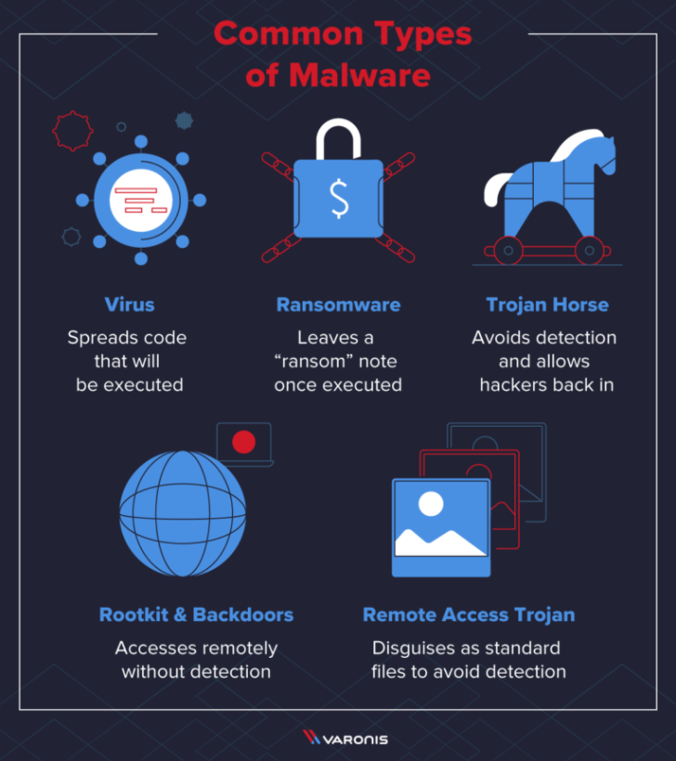
Types of Malware
Notes:
[Lauren] There are quite a few different types of malware and when you describe the TTPs of a given attack it can be helpful and important to describe the type of malware used. Some common terms are worm, virus, trojan, rootkit, backdoor, RAT, and ransomware.
A worm is standalone software which can replicate itself and infect multiple computers on a network. Network worms often use computer networks to spread, slowing down traffic and relying on security failures (such as outdated operating systems and lack of AV) to spread. While viruses require the spreading of a file, worms are a standalone software and do not require a host or human help to spread.
A virus is typically attached to an executable file which means that it might exist on a system but will not spread until a user opens the infected program. Viruses often originate on the internet and spread when downloading a file infected with a virus. Peer to peer file sharing and email attachments are other common methods through which viruses are spread.
A Botnet is a network of infected computers. There is a master computer which is infecting zombie computers. Then it can distribute its activity across all of the zombie computers. This is particularly important when you need a lot of traffic for your attack such as in a DDOS.
A trojan is a program that cannot reproduce itself but masquerades as something the user wants and tricks them into activating it so it can do its damage and spread.
Spyware typically rests on a system and collects information about the user and relays that back to the operator of the spyware. Adware is a type of spyware which relays this info back to an advertiser.
A rootkit is "a program or, more often, a collection of software tools that gives a threat actor remote access to and control over a computer or other system." (TechTarget) It gets its name because it's a kit of tools that (generally illicitly) gain root access (administrator-level control, in Unix terms) over the target system, and use that power to hide their presence.
Remote Access Trojans or RATs—essentially, rootkits that propagate like Trojans.
Ransomware is a flavor of malware that encrypts your hard drive's files and demands a payment, usually in Bitcoin, in exchange for the decryption key.
Backdoors are installed on a system by an attacker so that they can circumvent security measures to have persistent access to the system.

Slide 61
(Priority) Intelligence Requirements
Best practices for writing a good intelligence question:
Ask a single question
Rank the questions in order of importance
Be specific
Focus on findable facts
Additional considerations:
Ensure data sources are available to you to answer the question
Continue moving deeper down the question chain until you have a question which is a reasonable size for you to answer.
Notes:
Intelligence requirements are a tool which come out of military planning and are commonly used across government analytic endeavors. Over the past 10 years they have been ported over to the private sector and are a common tool used for example by client-facing companies to ensure the work they are doing is aligned to the client’s needs and are used by teams answering complex analytical questions to ensure cohesion across a group of analysts.
The idea is that intelligence requirements are then prioritized becoming priority intelligence requirements (PIRs) and that these drive associated collection requirements (CRs). Once you have your set of questions (PIRs) you can then go about identifying data sources from which you can collect info which can then be passed off to someone for analysis to try to address the initial PIRs.

Slide 62
Intelligence writing is not normal writing
Letter or essay style.
Red teaming exercises are important to our success in detecting APT intrusions. Specifically, we must prepare our SOC analysts to identify attacks to which our tooling alone will not alert us. Our analysts must learn to identify connections between alerts as opposed to just triaging each alert individually. They also need to know that this is an expectation of their job and not an optional approach to try only when we are exercising. If we engage the red team consistently then the SOC analysts will internalize this skill and be ready to identify real intrusions.
Memo style.
Red teaming exercises prepare SOC analysts to detect APT intrusions.
Greater than X% of sophisticated attacks are not detected by individual tools.
Analysts must identify connects in alerts across tools to identify sophisticated attacks.
Analysts cannot accomplish this by triaging individual alerts alone.
The business must set an expectation that all analysts seek to identify these connections in alerts across tools.
The business must create time during which analysts can conduct this work.
Red team exercises are one mechanism to provide analysts practice with this work.
Notes:
Intelligence writing is not meant to tell a story. It is meant to inform a decision. The practice of intelligence writing in the intelligence community is a highly structured endeavor with rigid style guides, templates, and manuals which dictate exactly how to use specific terminology and structure written content for maximum shared understanding of usage across all readers. In the private sector intelligence writing tends to be less formal and while we will not hold you to such a strict standard in this course it is helpful to understand the foundation of this writing style so that you can intentionally choose to depart from it as opposed to unknowingly bashing all of the norms and possibly leading to misunderstandings between yourself and the recipient.

Slide 63
Guidelines for intelligence writing
Put your main point up front aka bottom line up front (BLUF)
Write short paragraphs
Sentence 1: Topic sentence (the controlling idea of the paragraph).
Sentence 2: Explanation/elaboration of the topic sentence (if needed).
Sentence 3: Fact/example/illustration #1 to support the topic sentence.
Note: Facts should include technical artifacts inline or in an appendix.
Sentence 4: Fact/example/illustration #2 to support the topic sentence.
Sentence 5: Analysis (a sentence that answers the question “so what?”).
Use active voice
Use short, conventional words
Write short sentences
Include probability assessments
Be correct, credible, and complete
Correct: Grammar and syntax
Credible: State the assumptions on which your analysis rely
Complete: State the unknowns or gaps in your analysis
Know your audience
Notes:
When you go about writing finished intelligence (FINTEL) which might also just be more generally called an intelligence product you will want to follow the guidelines summarized here for your reference.

Slide 64
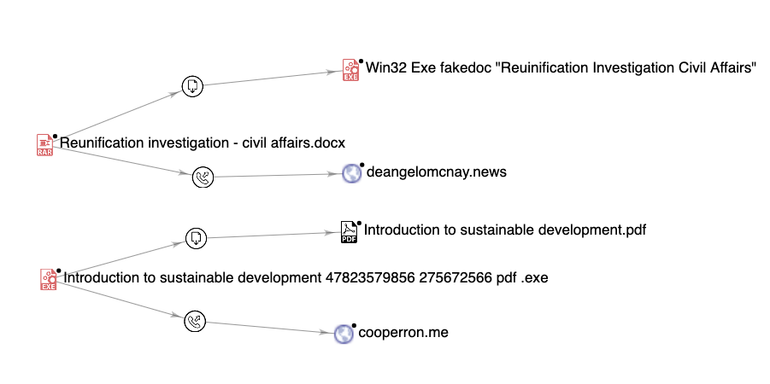
Intro to VirusTotal GraPh Example

Slide 65
Operational security aka opsec
Operational Security, more commonly called OPSEC, encompasses the steps an investigator must take to ensure that they do not inadvertently reveal information about themself to an adversary.

Slide 66
Defanging iocs
IP Address defanging
domain/url Defanging
Email defanging
Malware hashes
Defanging IOCs = making the IOCs safe to share by ensuring that no one, yourself included, who interacts with them will inadvertently click on the IOC.
Put brackets around every period in the IP address.
1[.]1[.]1[.]1
Replace the ts in http or https with xs and put brackets around the periods.
hxxps://www[.]evilwebsite[.]edu
www[.]reallybadtoclickon[.]com
Put brackets around the @ and around the period in the domain.
lbh22[@]georgetown[.]edu
Do not need to be defanged because the hash is just a unique representation of the file; it is not the file itself so having malware hashes on your machine is not a problem and clicking on them isn’t an issue.

